Slide 1


Royal Gorge Bridge
By Savannah

Slide 2
comparison
The royal gorge bridge is 1060 more ft than the tower bridge

Slide 3
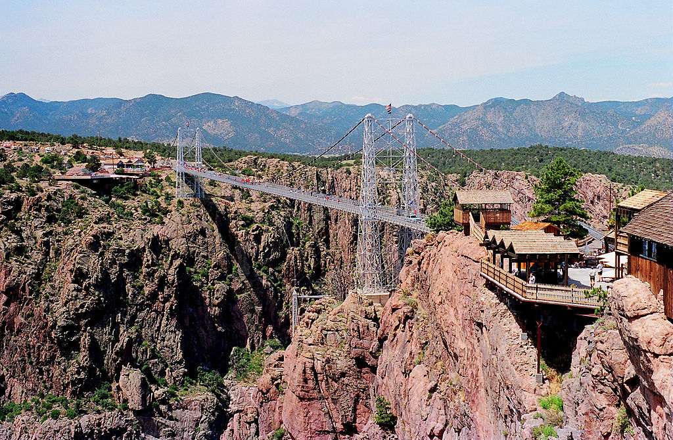
INTERESTING FACTS
First built in 1929
The bridge was built in seven months
The cost was 35,000 and 1,000,000 over budget

Slide 4
MEASUREMENTS
LENGTH 1,260 ft
HEIGHT 150 ft

Slide 5
Researched and produced by Savannah 2nd grade
Buck Lake Elementary, Tallahassee Fl 2019

